Slide 1


Customer Segmentation and Behavioral Analysis of Spotify Users
DAB303 – Marketing Analytics
Kateryna Podopryhora

Slide 2

Introduction and Objectives
Objectives:
Segment users based on their characteristics
Understand user behavior patterns within identified segments
Provide useful insights and recommendations for the company to create targeted marketing campaigns for different user segments
Notes:
Music Streaming has completely changed the music industry. Nowadays, most music listeners rely on music streaming services, and Spotify has a leading role in this industry.
Interest is analyzing customer behavior and segmenting users based on their listening habits, subscription plans, and preferences. This will give Spotify the ability to provide personalized content and recommendations, which is important for music streaming platforms.

Slide 3

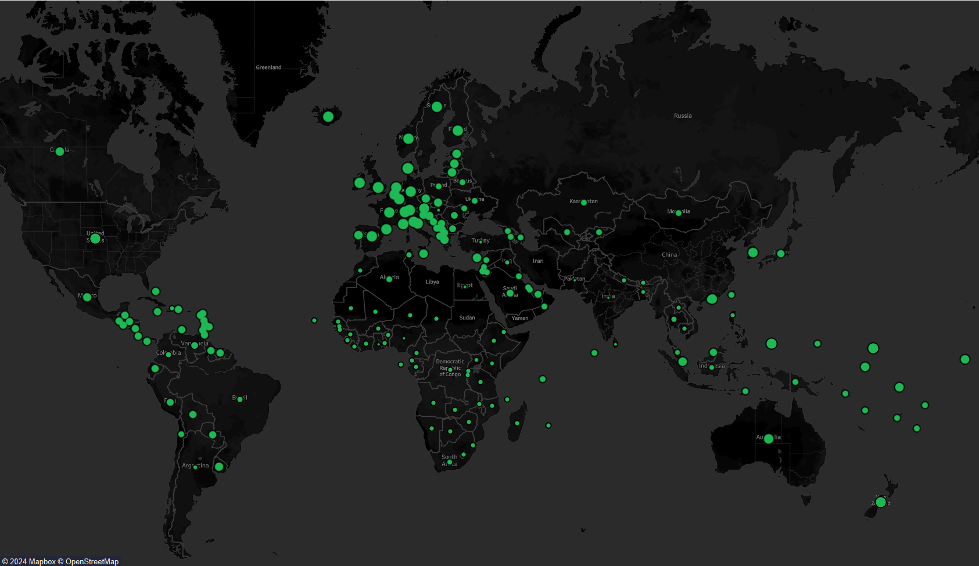
Company Overview
Swedish company, founded in 2006
One of the largest music streaming platforms as for the June 2024
Over 626 million active users, 246 million among them are paying subscribers
Offers more than 100 million songs and 6 million podcast titles
Is available in 237 countries and territories all over the world
Provides both Free and Premium subscriptions
3 different plans for Premium subscription
Notes:
Swedish company, founded in 2006
One of the largest music streaming platforms as for the June 2024
Over 626 million active users, 246 million among them are paying subscribers
Offers more than 100 million songs and 6 million podcast titles
Is available in 237 countries and territories all over the world
Provides both Free and Premium subscriptions
3 different plans for Premium subscription

Slide 4
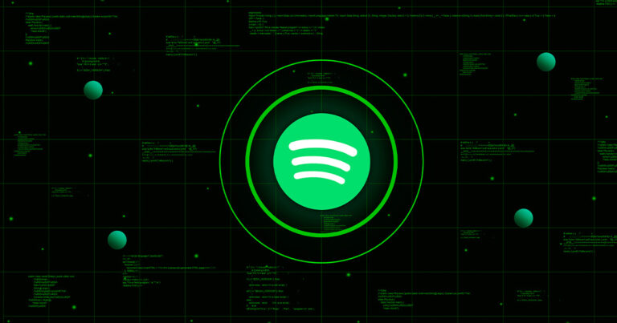
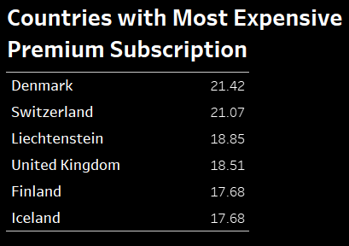
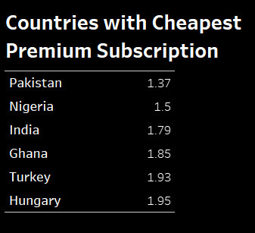
Company Overview
Spotify offers four subscription plans:
Free (add-supported)
Student Premium Plan
Family Premium Plan
Individual Premium Plan
All premium plans include:
Ad-free music listening
Download to listen offline
Play songs in any order
High audio quality
Listen with friends in real time
Organize listening queue

Slide 5

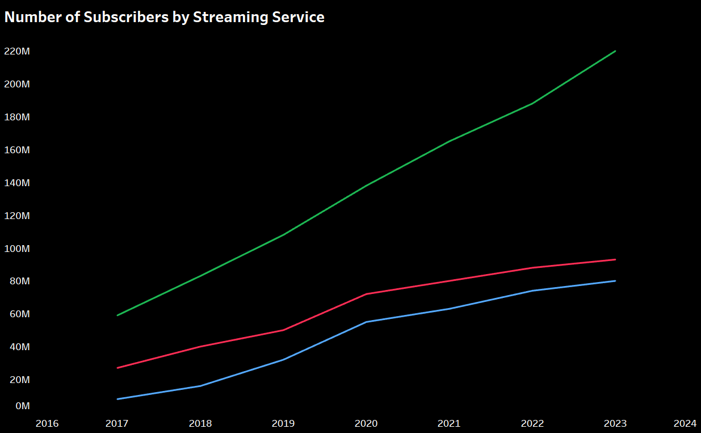
Market Share
“Big Three” of the world music streaming market are: Spotify, Apple Music, and Amazon Music
Number of Subscribers:
Spotify 165million (37% of market)
Apple Music 85million (18.7% of the market)
Amazon Music 14.1million (11.1% of the market)
Revenue:
Spotify $14.5 billion
Apple Music $9.2 billion
Amazon Music $5 billion

Slide 6

Market Problem
Customer Segmentation: There is a wide variety of users and it's important to understand how different customer segments use the platform.
Consumer Behavior Analysis: Spotify needs to understand how users behave on the platform, what genres they prefer, when they listen to music, and how satisfied they are with recommendations.
Notes:
Segmentation based on subscription plans, listening preferences, and device usage can help Spotify provide their users with personalized offers and improve their experience.

Slide 7
Data Overview
Data Source
Users Survey
Dataset Description
28546 rows and 20 columns
Updated 5 months ago, no information about data spread
Contains information about customer preferences and behavior on Spotify
Notes:
The dataset originates from a survey of Spotify users, which collects information about their demographics, listening habits, subscription choices, and preferences for music and podcasts.

Slide 8
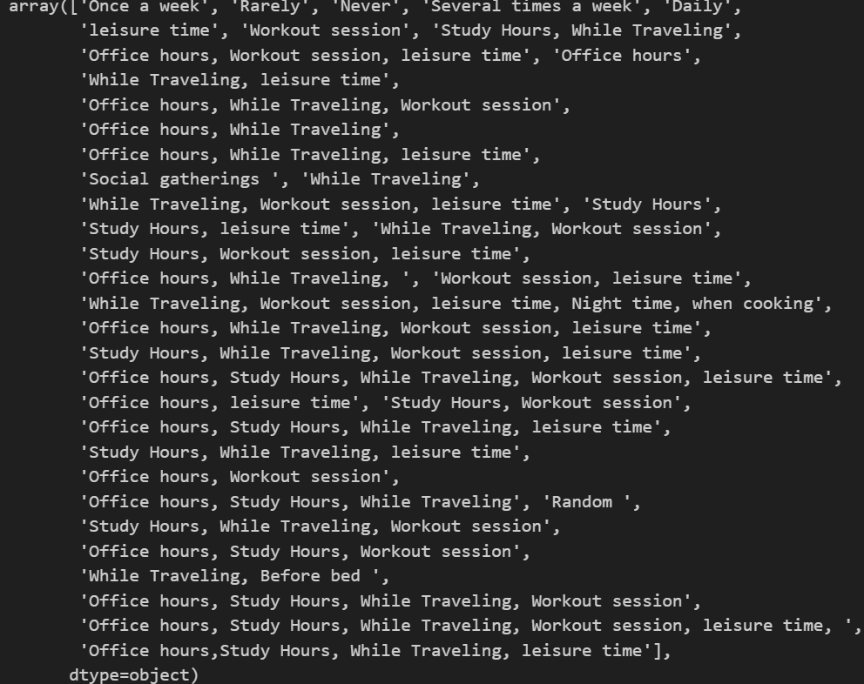
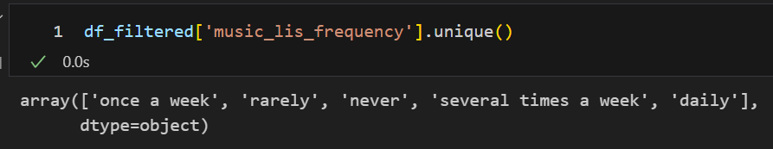
Exploratory Data Analysis
Inconsistency in ‘music_lis_frequency’
Filtering applied based on music listening frequency
Length of filtered data 18627 rows, which is 65% of the original data
Notes:
Values in the ‘music_lis_frequency’ column were inconsistent and of an extremely wide variety.
Data was filtered by the condition that the length of ‘music_lis_frequency’ is 1 and represents the frequency like: ‘daily’, ‘rarely’, ‘several times a week’, etc.
The length of filtered data is 18627 rows out of 28645, which is 65% of the original data and is significant for analysis.

Slide 9
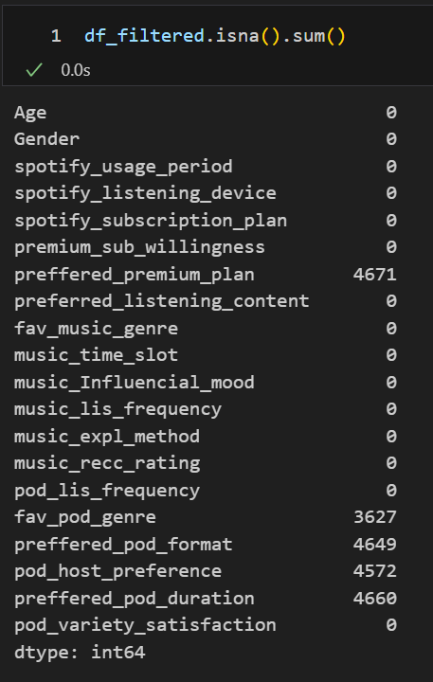
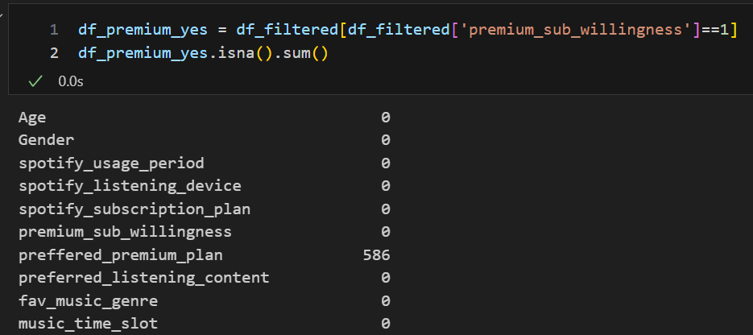
Exploratory Data Analysis
Handling missing values
‘preffered_premium_plan’ column contains 4671 missing values
75% of the missing values for those users who have premium plan
Missing values replaced with current premium plan
After replacing 1172 missing values left, and only 586 for those whose ‘premium_sub_willingness’ was ‘Yes’.
Notes:
Most of the missing values are in columns regarding podcasts. I don’t plan use these features for my analysis, so they were left as they are.
‘preffered_premium_plan’ column contains 4671 missing values which is 25% and is a significant amount.
When checked, it was figured out that 75% of the missing values were for those users who already had premium plan.
Assumed that they were satisfied with their plan, so their ‘preffered_premium_plan’ was filled in with their ‘spotify_subscription_plan’.
After replacing the values, there were only 1172 missing values, and only 586 for those whose ‘premium_sub_willingness’ was ‘Yes’. That makes only 3% of the dataset and has minimal impact on the analysis results.

Slide 10
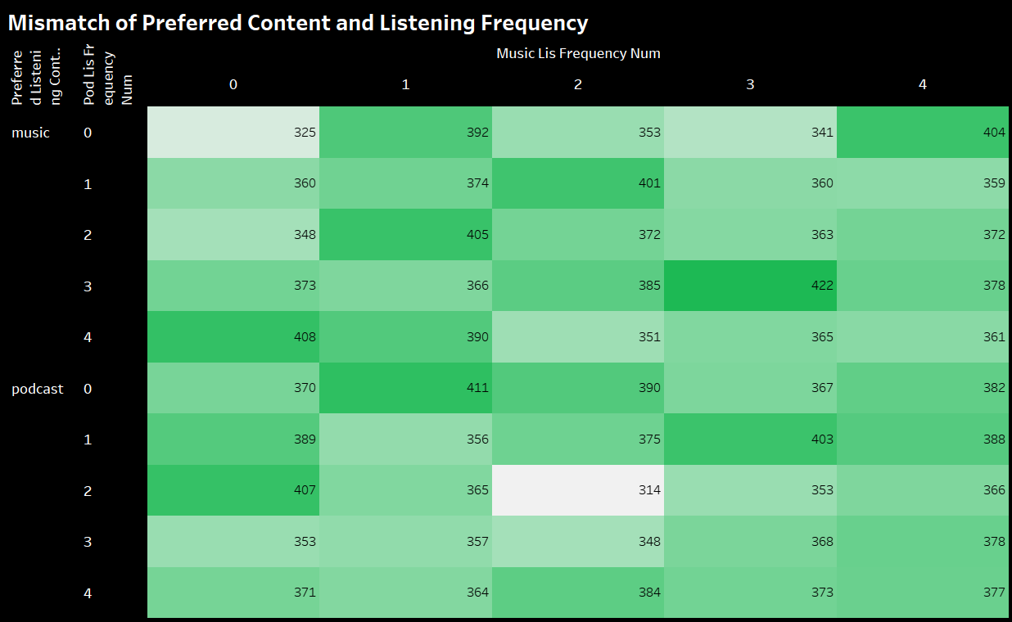
Exploratory Data Analysis
40% of users who specified music as their preferred listening content, listen to podcasts more frequently
40% of users who chose podcasts as their preferred content tend to have higher frequency of music listening
Identifying the reasons for this is an area for further analysis.
Notes:
During analysis it was identified that 40% of users who specified music as their preferred listening content, actually listen to podcasts more frequently.
Conversely, 40% of users who chose podcasts as their preferred content tend to have higher frequency of music listening.
Identifying the reasons for this is an area for further analysis.

Slide 11
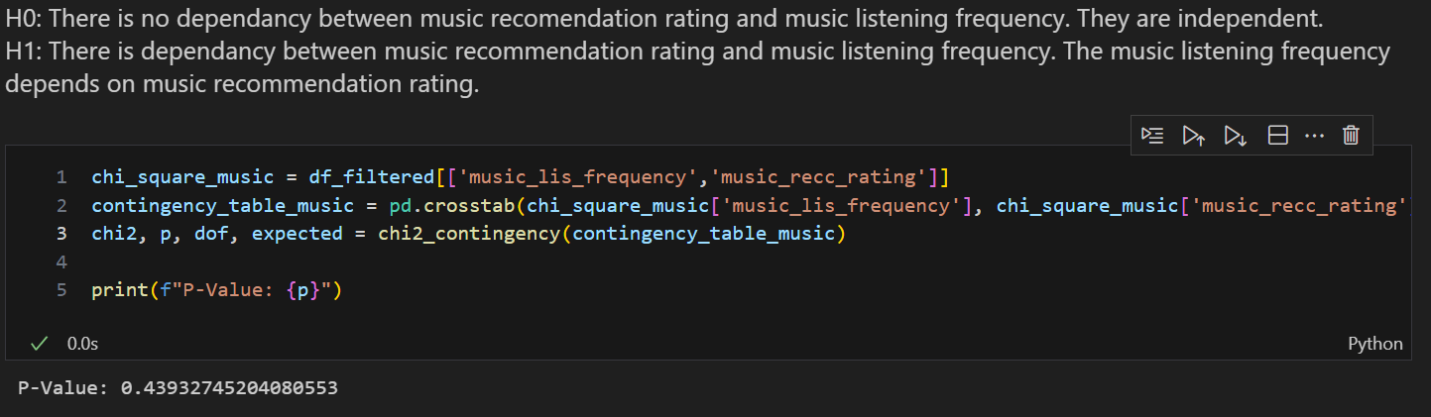
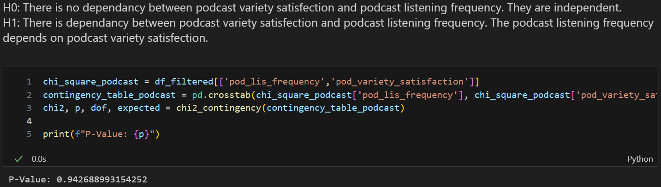
Chi-Square Test of Independence
Possible reasons for mismatch
Dissatisfaction with music recommendations for those who prefer music and podcast variety for those who prefer podcasts.
Chi-Square Test of Independency was applied
Respondents might misrepresent their actual preferences during survey
Certain mood or occasion for listening
Notes:
Possible reasons for mismatch between preferred content and actual listening frequency could be:
Dissatisfaction with music recommendations for those who prefer music and podcast variety for those who prefer podcasts. When checked, it was identified that 40% of those who prefer music have low music recommendation rating and 40% of podcast preferers are either very dissatisfied or dissatisfied with podcast variety. To determine if there is a dependency between music recommendation rating and music listening frequency, as well as between podcast variety satisfaction and podcast listening frequency a Chi-Square Test of Independency was applied.
Respondents might misrepresent their actual preferences during survey
Certain mood or occasion for listening (to identify the influential factors more demographic and behavioral data is needed).
Since both p-values are very high, we fail to reject null hypothesis. There is no dependency between listening frequency and recommendation/variety satisfaction

Slide 12





Customer Segments
Two types of segmentation applied
Engagement Based
Content Based

Slide 13
Customer Segments
Content Based
Engagement Based
8 groups were identified:
Balanced Listeners
Music Enthusiasts
Podcast Enthusiasts
Music and Podcast Enthusiasts
Music Dominant
Podcast Dominant
Occasional Listeners
Infrequent Listeners
KMeans clustering was applied to identify 5 clusters:
Loyal Free
Loyal Premium
Low-engagement Premium
Engaged Premium Starters
Engaged Free Starters
Notes:
8 groups were identified:
Balanced Listeners
Music Enthusiasts
Podcast Enthusiasts
Music and Podcast Enthusiasts
Music Dominant
Podcast Dominant
Occasional Listeners
Infrequent Listeners
KMeans clustering was applied to identify 5 clusters:
Loyal Free
Loyal Premium
Low-engagement Premium
Engaged Premium Starters
Engaged Free Starters

Slide 14
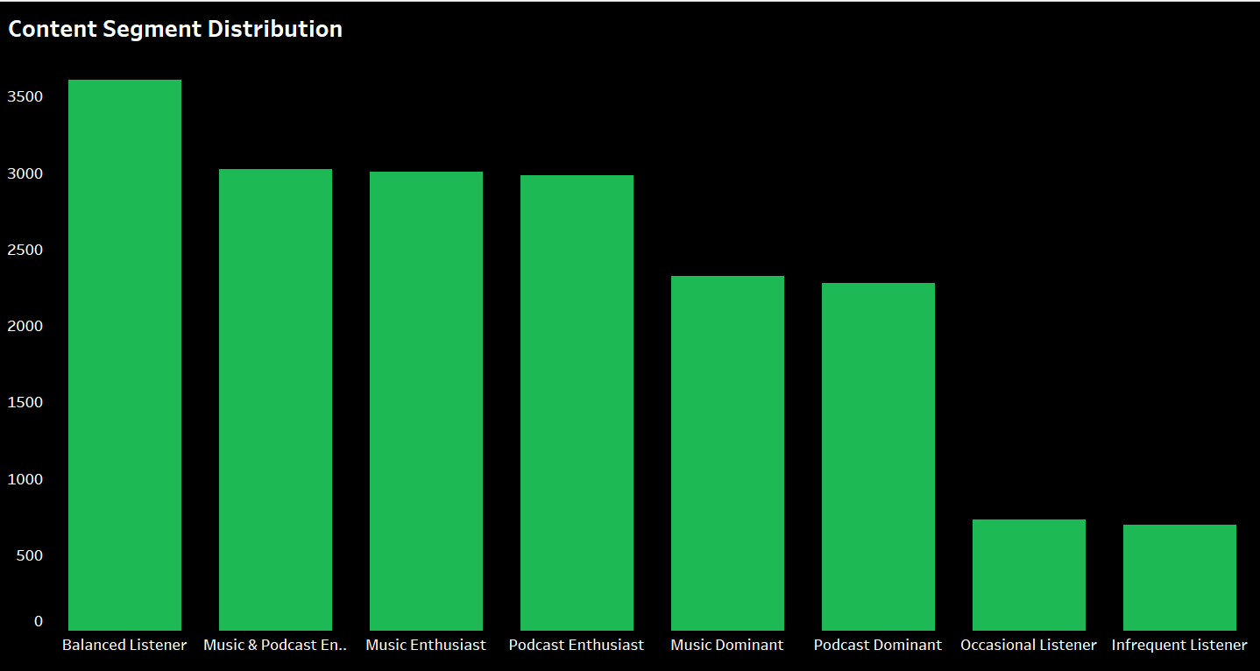
Content Based Segmentation
The biggest group ( 19.35%) of users are Balanced Listeners with moderate listening frequency for both music and podcasts.
Next three biggest groups (about 16% each) are Music & Podcast Enthusiast, Music Enthusiast, Podcast Enthusiast, which indicates high engagement of most of the Spotify users.
The smallest groups are Occasional Listener and Infrequent Listener (4% and 3% respectively). The reasons of their low engagement are the points for further analysis.

Slide 15
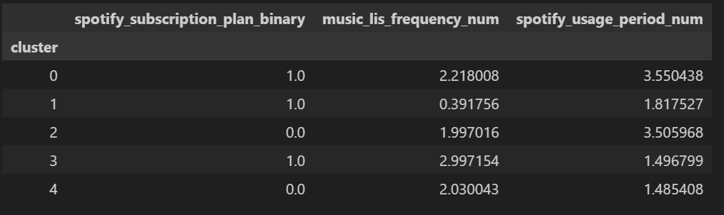
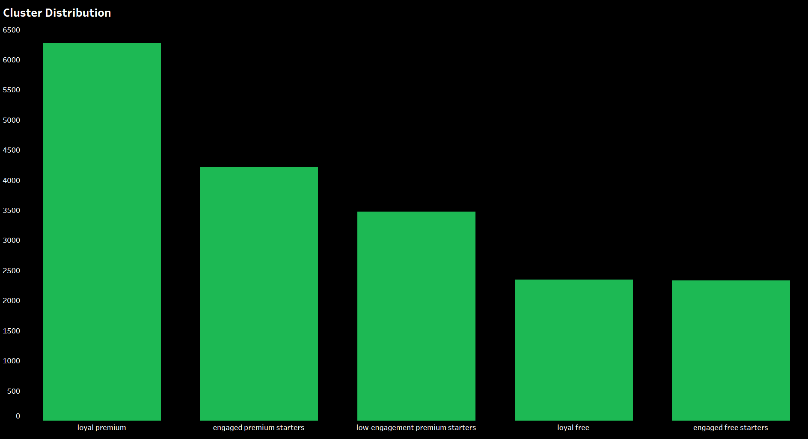
Engagement Clusters
Cluster 0 (Loyal Premium): users with premium subscription, long usage period and high engagement.
Cluster 1 (Low Engagement Premium Starters): premium users with moderate usage period and very low engagement.
Cluster 2 (Loyal Free): free users with long usage period and quite high engagement.
Cluster 3 (Premium Starters): new premium users with high engagement.
Cluster 4 (Free Starters): new free users with quite high engagement.

Slide 16
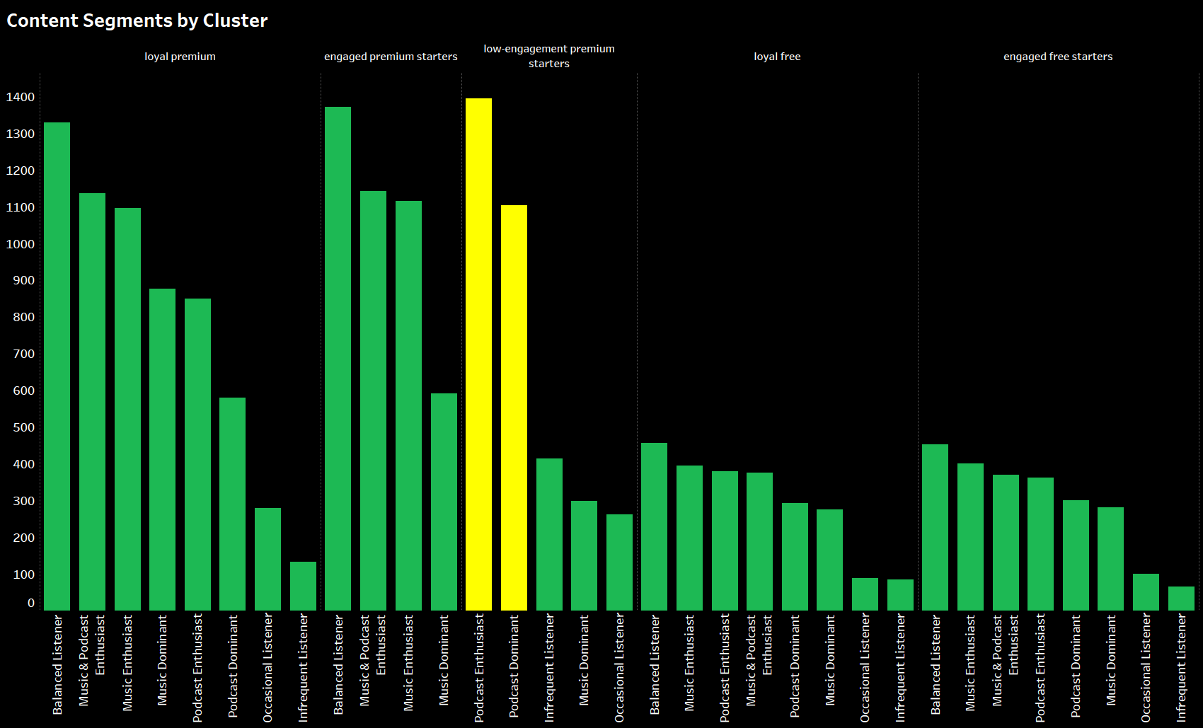
Behavioral Analysis
Major part of ‘low-engagement premium starters’ cluster are Podcast Enthusiast and Podcast Dominant segments.
Further analysis will be focused on defining the reasons of low engagement for these two segments and trying do understand the reasons why loyal free customers do not proceed with premium subscription.

Slide 17
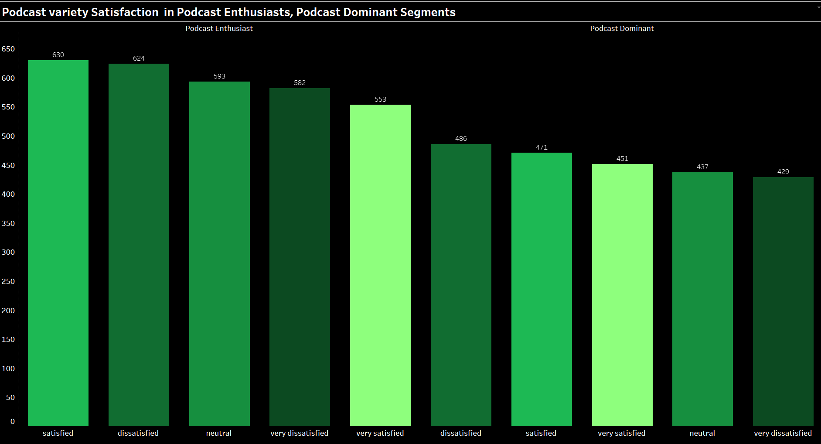
Behavioral Analysis
Big part, 40%, of Podcast Enthusiast segment are either dissatisfied or very dissatisfied with podcast variety, almost 20% feel neutral about podcast variety.
41% of users in Podcast Dominant segment are dissatisfied or very dissatisfied with podcast variety.
This gives an understanding of their low engagement.

Slide 18
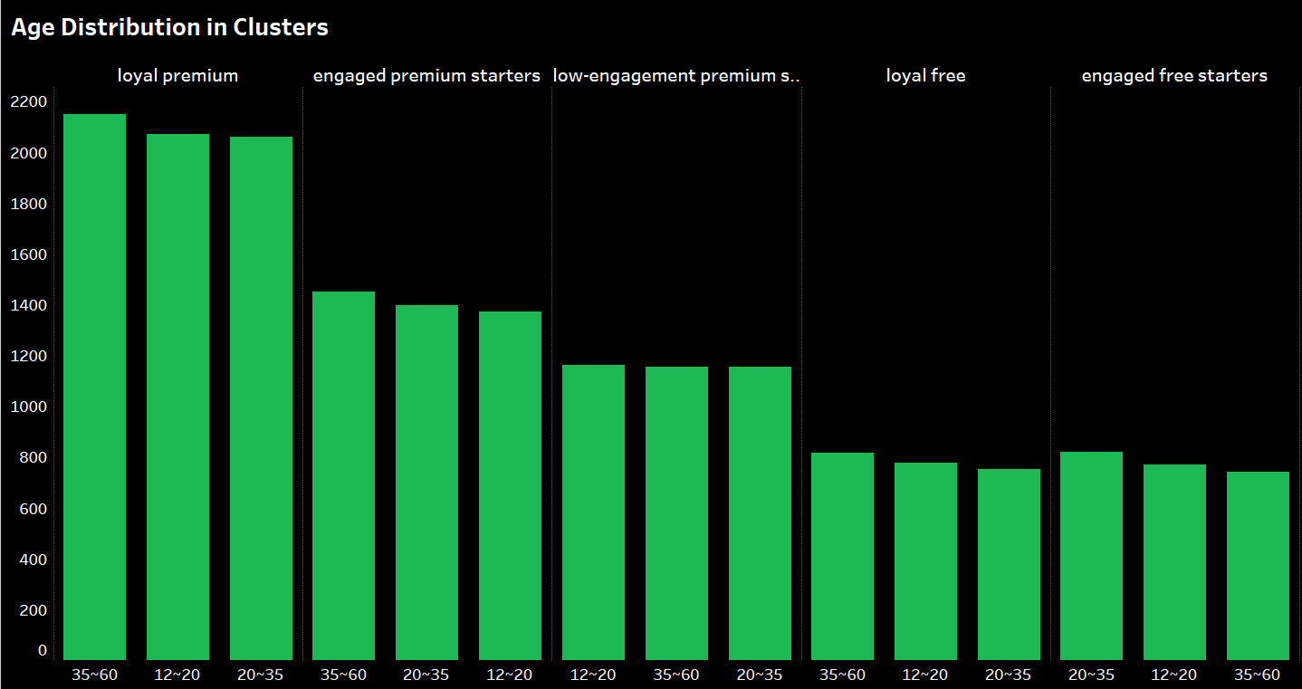
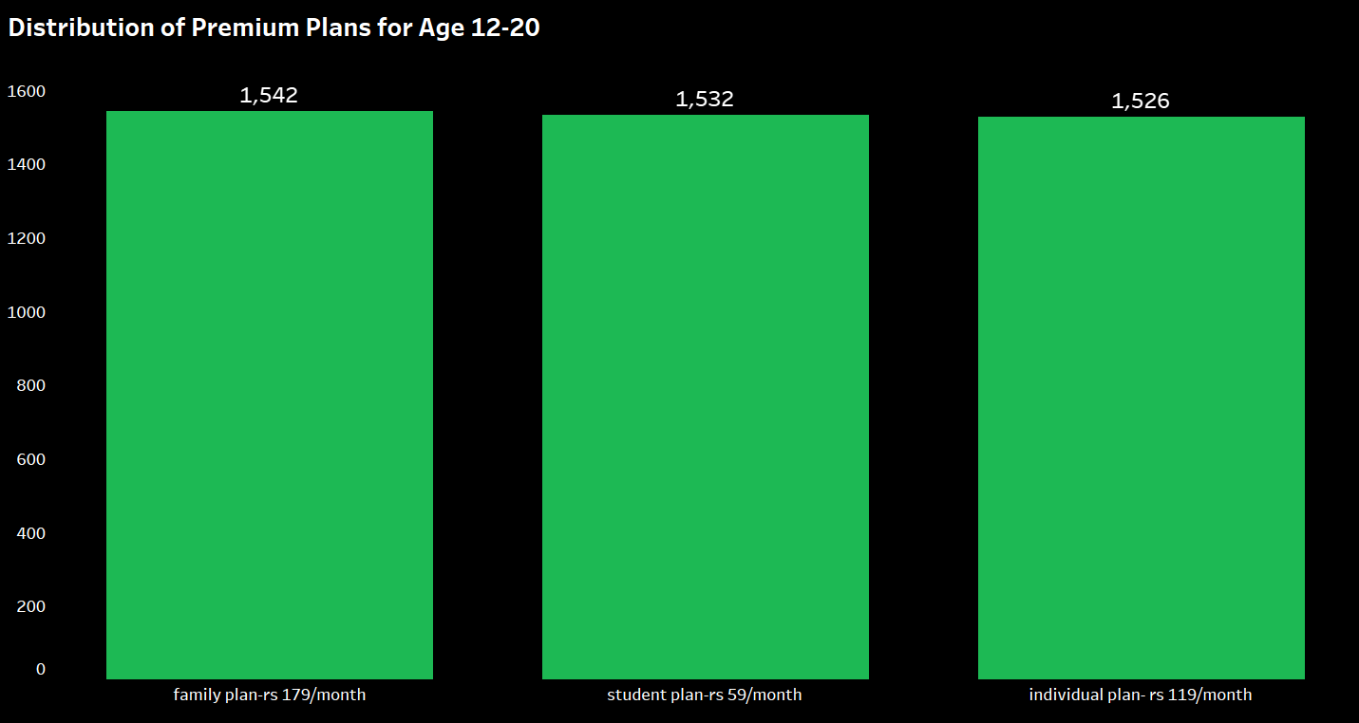
Behavioral Analysis
The majority of the premium clusters is age group 35-60, which is expected as this group of users has greater financial stability.
Interestingly, the second biggest group in loyal premium consist of people of age 12-20.
But if we look at the Premium Plans Distribution for this particular age group, we see that the most popular premium plan is family plan which is most likely financed by their parents/guardians, and the second most popular is student plan which is the cheapest and most affordable. These two premium plans contain almost 67% of users of this age group who have premium plan.

Slide 19
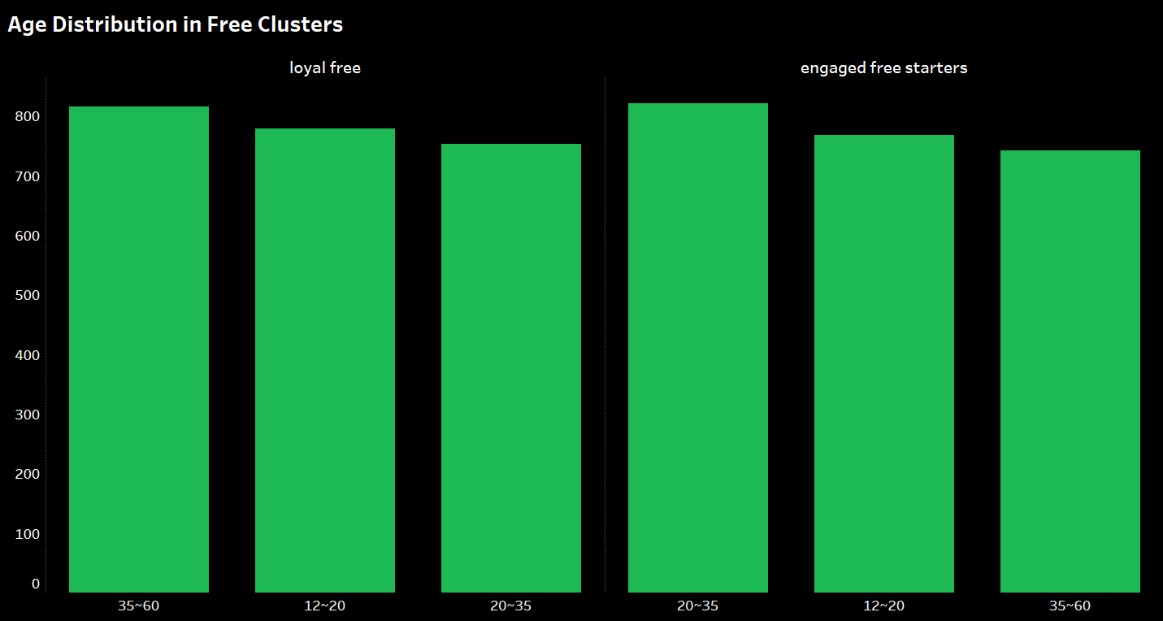
Behavioral Analysis
Looking closer at the age distribution within free subscription clusters, we can see that loyal customers are mostly represented by age group 35-60 while starters have more people of 20-35.
Young people are joining the company more, but they either do not stay with company at all or switch to premium account. This assumption must be checked with further analysis.

Slide 20
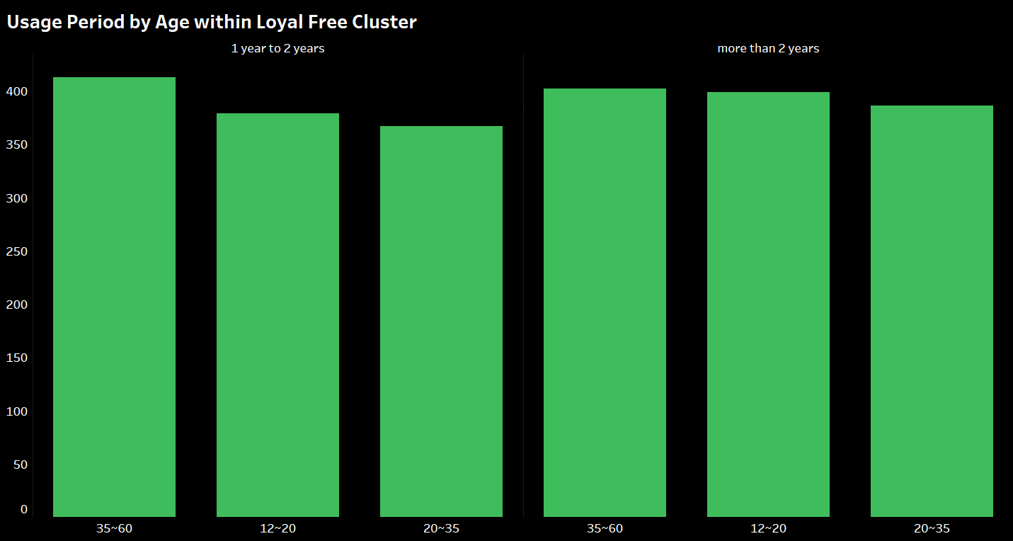
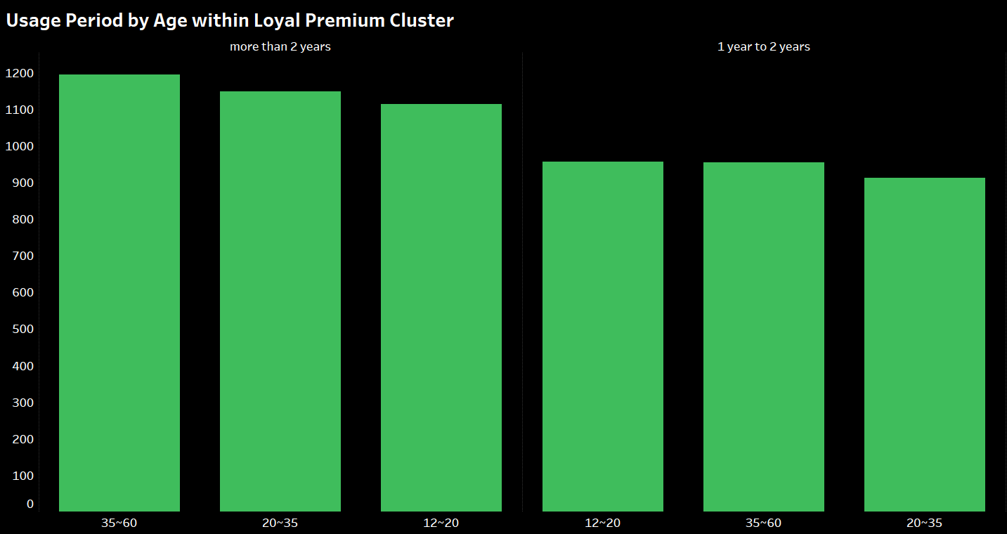
Behavioral Analysis
In Loyal Free Cluster age group 20-35 is least represented
In Premium Loyal Cluster this group is on the second spot
That might prove our suggestion that people of this age group are switching from free plan to the premium. But more detailed analysis on that is needed.
Notes:
If we look at the age distribution within Loyal clusters, we see that in Loyal Free Cluster age group 20-35 is least represented, but in Premium Loyal Cluster they are on the second spot.
That might prove our suggestion that people of this age group are switching from free plan to the premium. But more detailed analysis on that is needed.

Slide 21
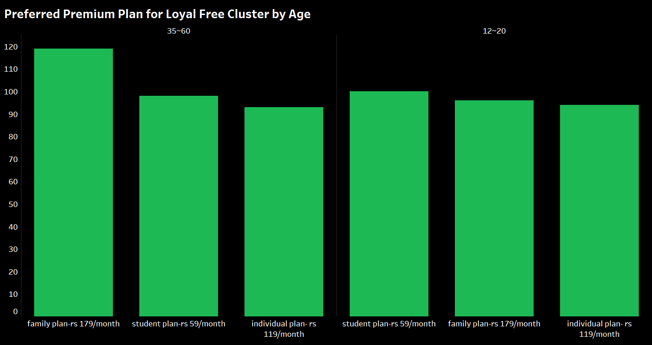
Behavioral Analysis
Two biggest age groups in Free Loyal cluster are 12-20 and 35-60.
For the group 35-60 the most preferred plan is family plan
Same reason might be applicable for the group 12-20
Notes:
Two biggest age groups in Free Loyal cluster are 12-20 and 35-60.
For the group 35-60 the most preferred plan is family plan, which is the most expensive. Maybe people do not switch to the premium plan by financial reasons.
Same reason might be applicable for the group 12-20. As these people are very young and might not have stable and reliable income, they might not afford premium subscription. Especially those who prefer family plan.

Slide 22

Recommendations
1
Improve Podcast Recommendation System
2
Motivate Free Users Move Towards Premium Subscription
3
Encourage Engagement
4
Expand Behavioral Analysis
5
Optimize Content for Low-engagement Users
Notes:
Improve Podcast Recommendation System
Podcast and Music listeners are equal parts of Spotify users. But significant part of podcast listeners are not satisfied with the recommendation system which leads to their low engagement. By improving it, Spotify will greatly improve customer satisfaction level.
Motivate Free Users Move Towards Premium Subscription
Loyal Free cluster show high engagement but do not shift to premium. Two largest groups of this cluster are 12-20 and 35-60. Develop targeted offers for long-term free users within these age groups to proceed for premium subscription.
Encourage Engagement
Third largest cluster of users have low engagement. Create some kind of rewards or bonuses like exclusive content for high activity to motivate users for higher activity.
Expand Behavioral Analysis
Conduct further studies to understand the reasons behind mismatch between preferred content and actual listening frequency.
Identify barriers for certain age groups to proceed to premium subscription.
Optimize content for low-engagement users
Analyze why some users have low engagement and create personalized recommendation system to improve their engagement.

Slide 23

Conclusion
The objective of the project was to segment Spotify users based on their characteristics and investigate their behavioral patterns.
Two types of segmentation were successfully implemented.
Based on the segments defined, behavioral analysis was made, and some useful insights were gained.
For deeper analysis and better understanding of Spotify users’ behavior more demographic data is needed.

Slide 24

References
https://backlinko.com/spotify-users#spotify-paying-subscribers
https://www.businessofapps.com/data/spotify-statistics/
https://explodingtopics.com/blog/music-streaming-stats
https://business.adobe.com/blog/basics/behavioral-analysis#how-do-you-conduct-behavioral-analysis
https://sxmbusiness.com/music-streaming-market-share-and-revenue-statistics/

